Slide 1

Masikhule Solutions
BIAS IN AI EMPLOYMENT PREDICTION: A SOUTH AFRICAN LENS
Auditing and Mitigating Bias for Equitable Hiring

Slide 2

OVERVIEW
Synthetic dataset audit: Employment prediction (income > R50,000/year).
Focus: Gender (Female/Male) and race (Non-White/White) biases in SA.
Simulated IBM AI Fairness 360 for metrics and mitigations (McKinsey Global Institute, 2025).
SA Context: 33.2% unemployment (Statistics SA, 2025), Gini 0.63 (Coetzer & van Zyl, 2024), BEE goals (Govender, 2024).

Slide 3

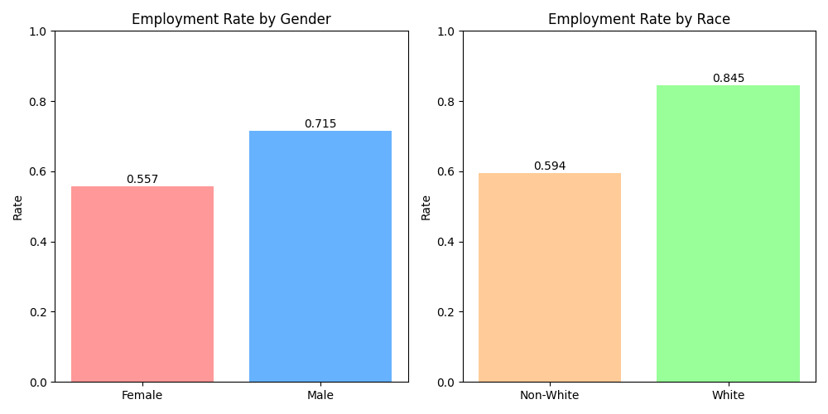
KEY BIAS PATTERNS DISCOVERED
Dataset: 2,000 samples (80% non-White, 51% female, Stats SA-based) (Coetzer & van Zyl, 2024).
Gender: Females 16% lower employment rate (0.557 vs. 0.715) (Makhafola, 2024).
Race: Non-Whites 25% lower (0.594 vs. 0.845) (Makhafola, 2024).
Validated: Chi-squared (p<3.69e-13 gender, p<1.17e-19 race).

Slide 4
BASELINE FAIRNESS METRICS
Baseline Accuracy: 0.6775
Baseline Fairness Metrics:
Metric Gender Race
0 Disparate Impact (DP) 0.696 0.788
1 EO Difference 0.185 0.132
2 EOdds TPR Diff 0.185 0.132
3 EOdds FPR Diff 0.416 0.319
Accuracy: 67.75% (logistic regression) (McKinsey Global Institute, 2025).
Disparate Impact (DP, ideal=1): Gender 0.696, Race 0.788.
Equal Opportunity Difference (EO, ideal=0): Gender 0.185, Race 0.132.
Equalized Odds: TPR/FPR diffs show bias (Makhafola, 2024).

Slide 5
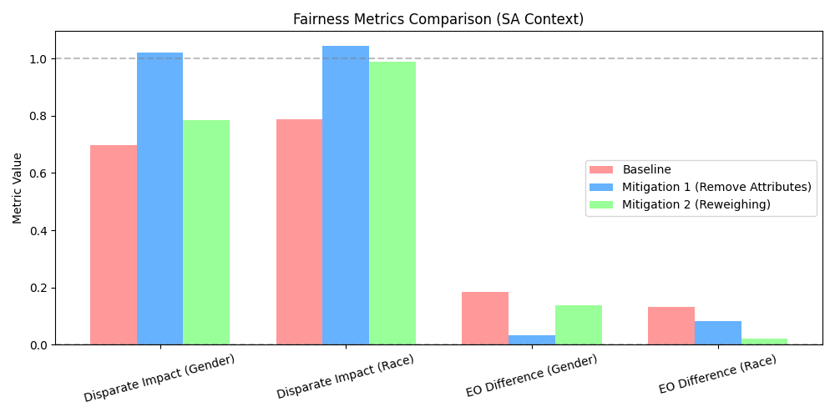
MITIGATION STRATEGIES IMPLEMENTED
Simulated IBM AI Fairness 360 (McKinsey Global Institute, 2025).
Preprocessing: Removed gender/race (DP: 1.020 Gender, 1.043 Race).
Reweighing: Adjusted race weights (DP: 0.784 Gender, 0.989 Race).
Accuracy: 63.50-65.00%, fairness improved (Makhafola, 2024).

Slide 6
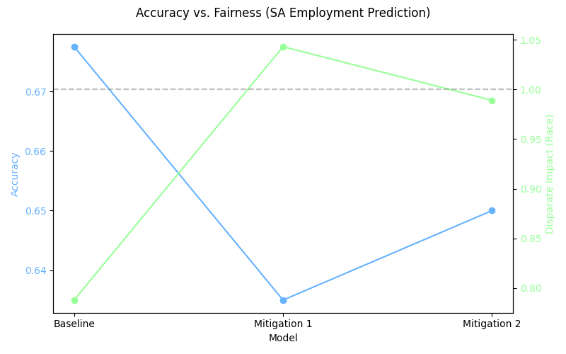
ACCURACY VS. FAIRNESS TRADE-OFF
Baseline: Accuracy 67.75%, DP (Race) 0.788.
Mitigation 1: Accuracy 63.50% (-4.25%), DP 1.043.
Mitigation 2: Accuracy 65.00% (-2.75%), DP 0.989.
Fairness prioritized for SA equity (Govender, 2024).

Slide 7
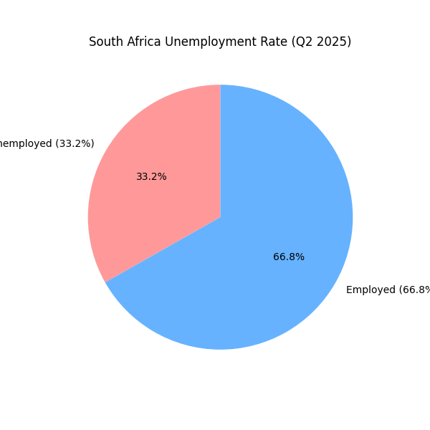
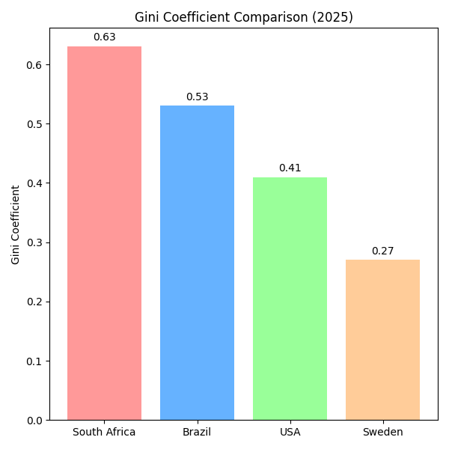
REAL-WORLD IMPLICATIONS
Risks job denials, worsening 33.2% unemployment (Statistics SA, 2025).
Violates Employment Equity Act, widens Gini (0.63) (Coetzer & van Zyl, 2024).
Undermines BEE, perpetuates apartheid inequities (PwC South Africa, 2023).
Harms: Poverty, social unrest (Ndung’u & Signé, 2024).

Slide 8

RECOMMENDATIONS & ETHICS
Accountability
Developers: Balance data, use skills-based features (McKinsey Global Institute, 2025).
Policymakers: Mandate audits, align with SA AI Policy (UNESCO, 2024).
Ethics: Accountability, inclusivity, fairness (see Ethics_Statement.docx) (Ndung’u & Signé, 2024).
Q&A: How to ensure fair AI in SA?
Inclusivity
Fairness
Monitoring

Slide 9
THANK YOU!
FOR YOUR ATTENTION

